Slide 1



Digital hotspot
December 1st – 2nd 2021 Belgrade
Powered by

Slide 2
Azure Container Apps, novi serverless servis za kontejnere
Ratomir Vukadin
December 1st – 2nd 2021 Belgrade
Powered by

Slide 3
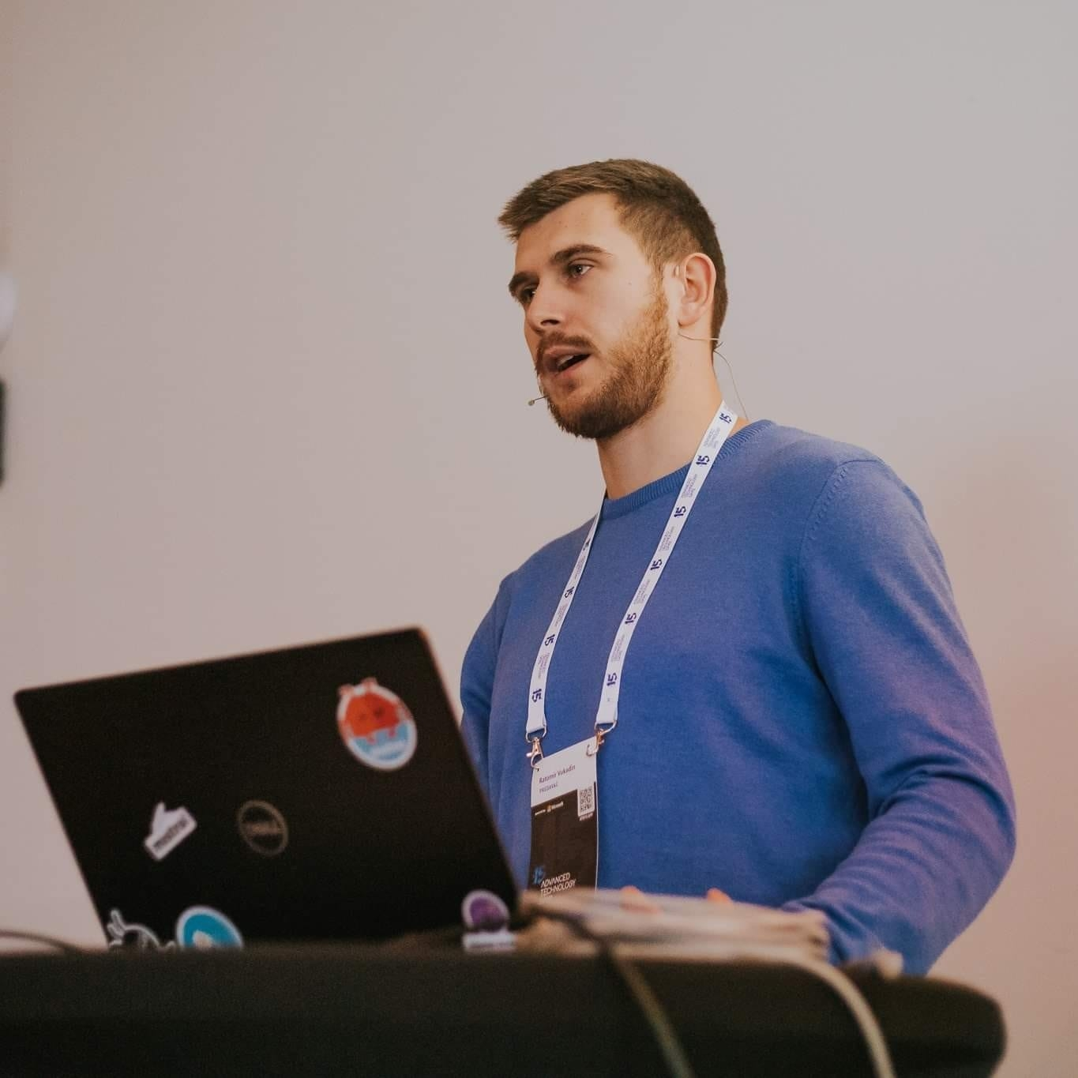
https://www.linkedin.com/in/ratomir-vukadin-rvs/
https://twitter.com/Ratko_V
https://github.com/Ratomir
Network 9, WinDays19, Azure Bootcamp, Tarabica19, Sinergija19, MS Community 8, ATD15…
Ratomir Vukadin
DevOps Engineer – Mistral www.mistral.ba
https://github.com/Ratomir/Sinergija21

Slide 4


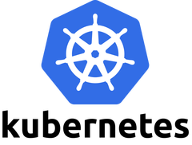



Kubernetes
Is hard?
Give a like if you agree
Angry if you disagree

Slide 5

Kubernetes – as first
Huge community
The most powerful application platform for containerized workloads
Multi-cloud capability
Open source
Proven and battle-tested
Market leader

Slide 6
Kubernetes
Learning curve of complexity
Kubernetes sits on top of infrastructure
Add complexity, cost, speed
Developers want focus on business problems

Slide 7
Kubernetes disadvantages
Overkill for simple applications
Very complex and can reduce productivity
More expensive than its alternatives (dedicated team members)
Diverse knowledge needed
Infrastructure may cost more than planned - Kubernetes instance calculator (learnk8s.io)
Notes:
Dodijeljeni clanovi tima
Pratiti k8s

Slide 8

Azure Container Apps
Public preview
Ignite 2021
Innovate with cloud-native apps and open source on Azure (microsoft.com)
Introducing Azure Container Apps: a serverless container service for running modern apps at scale (microsoft.com)

Slide 9
Azure Container Apps
Serverless containers for microservices
Serverless platform
Top of Kubernetes
Fully managed
Abstraction layer around of Kubernetes
No VMs under carpet, orchestrators, other cloud infrastructure
Notes:
U potpunosti serverless platforma
Top of k8s

Slide 10
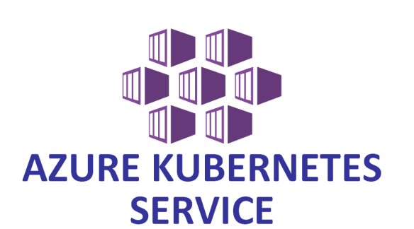
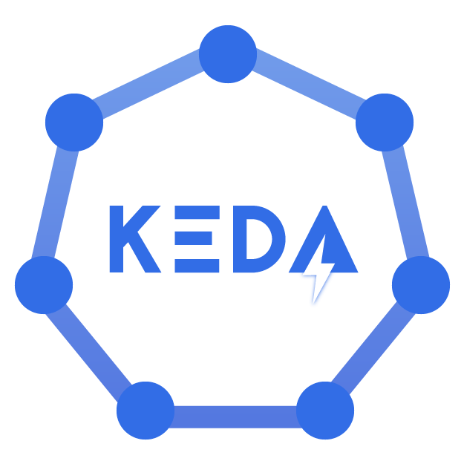

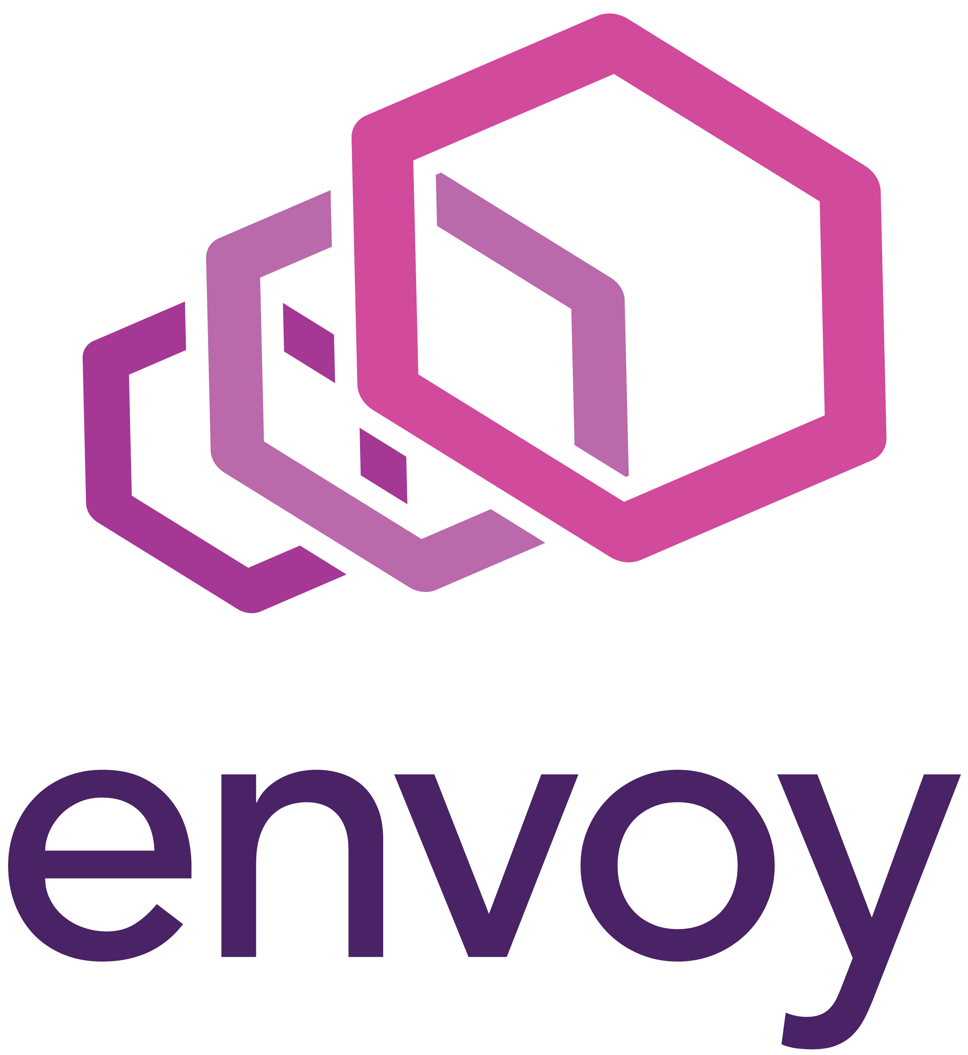
Azure Container Apps
Build on the powerful open-source technologies involved in the k8s ecosystem
AKS
DAPR
KEDA
Envoy Proxy

Slide 11
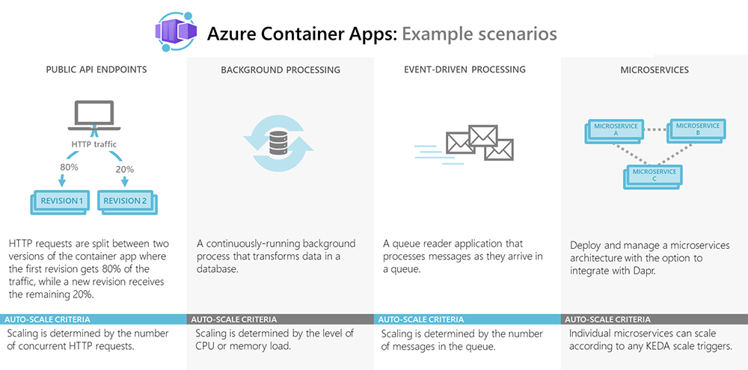
Azure Container Apps Preview overview | Microsoft Docs
Notes:
Azure Container Apps enables you to run microservices and containerized applications on a serverless platform. Common uses of Azure Container Apps include:
Deploying API endpoints
Hosting background processing applications
Handling event-driven processing
Running microservices
Azure Container Apps enables executing application code packaged in any container and is unopinionated about runtime or programming model. With Container Apps, you enjoy the benefits of running containers while leaving behind the concerns of managing cloud infrastructure and complex container orchestrators.

Slide 12
Core concepts in Azure Container Apps
Environments
Containers
Revisions

Slide 13
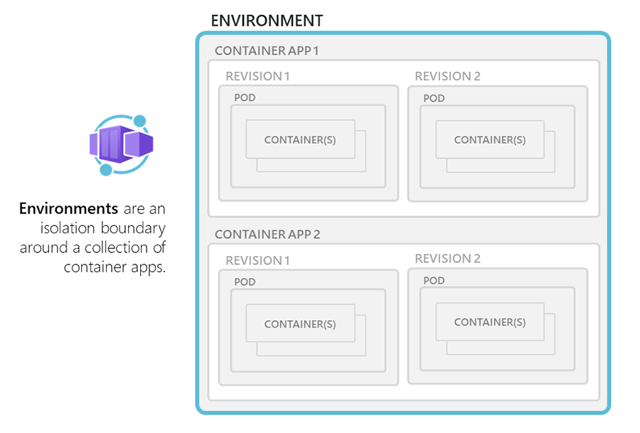
Environments in Azure Container Apps
An environment consists of at least one container app
All container apps are deployed into a Virtual Network
All logs go into dedicated Azure Log Analytics Workspace
Azure Container Apps environments Preview | Microsoft Docs
Notes:
Reasons to deploy container apps to the same environment include situations when you need to:
Manage related services
Deploy different applications to the same virtual network
Have applications communicate with each other using Dapr
Have applications to share the same Dapr configuration
Have applications share the same log analytics workspace
Reasons to deploy container apps to different environments include situations when you want to ensure:
Two applications never share the same compute resources
Two applications can't communicate with each other via Dapr

Slide 14
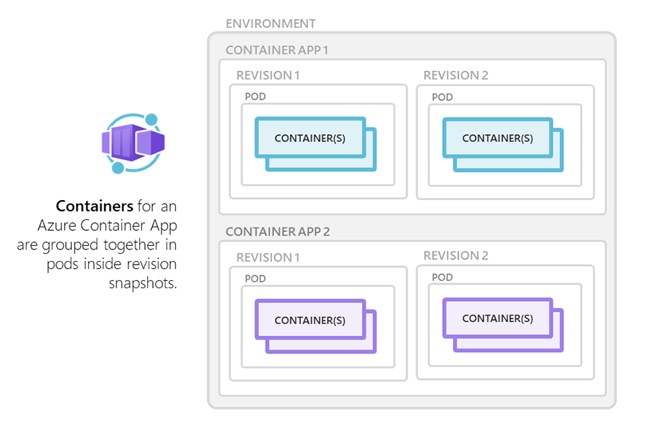
Containers in Azure Container Apps
Container Apps uses Pods to run containers
Pods can contain multiple containers, a sidecar pattern in Kubernetes
Share resources, only Linux based containers only
Notes:
Azure Container Apps supports:
Any Linux-based container image
Containers from any public or private container registry
Additional features include:
There is no required base container image.
Changes to the template ARM configuration section triggers a new container app revision.
If a container crashes, it automatically restarts.

Slide 15
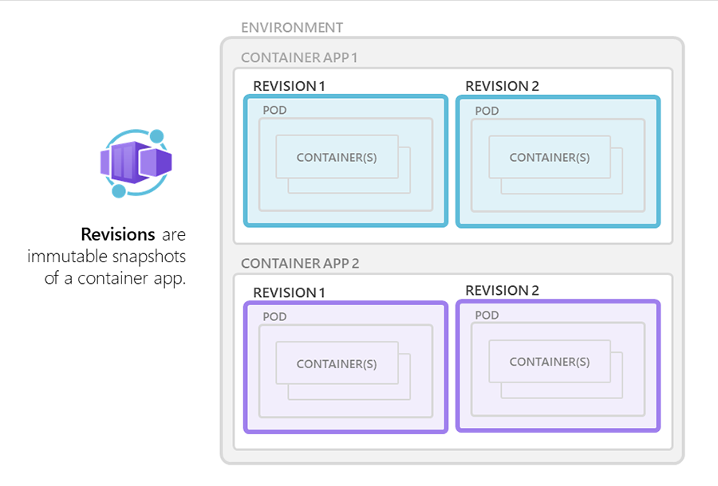
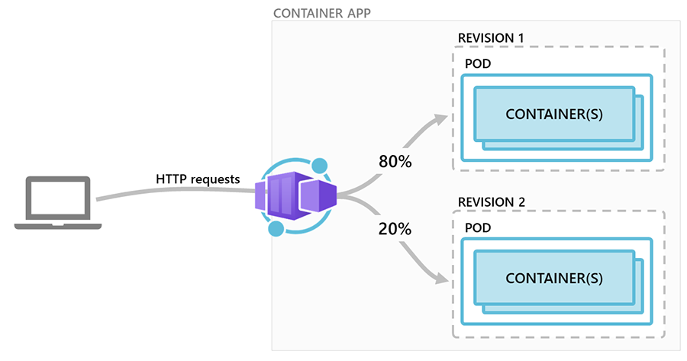
Revisions in Azure Container Apps
A revision is an immutable snapshot of a Pod
A container consists of at least one revision, the first revision is automatically created
Active and inactive revisions, at least one active
If a revision is not needed anymore, deactivate option
Traffic direction strategies - A/B testing and BlueGreen deployment
Notes:
The following types of changes create a new revision:
Changes to containers
Add or update scaling rules
Changes to Dapr settings
Any change that affects the template section of the configuration

Slide 16
Demo
Hello world Azure Container Apps
Trigger Azure function from Azure Queue
Multiple trigger
Two revisions with 50-50 traffic routing

Slide 17
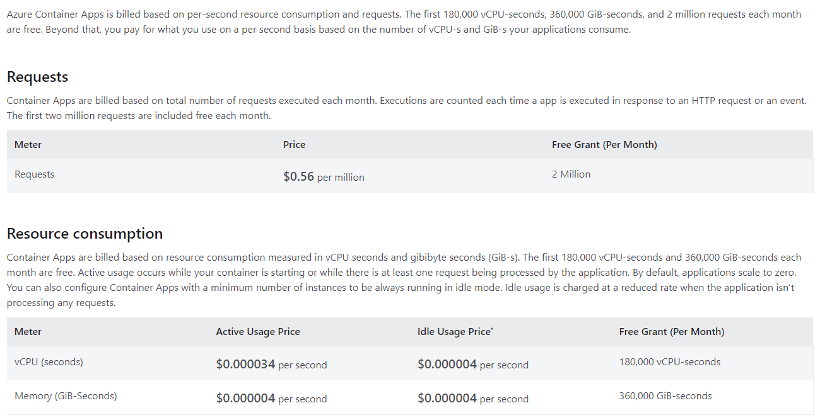
Pricing
Azure Container Apps - Pricing | Microsoft Azure

Slide 18
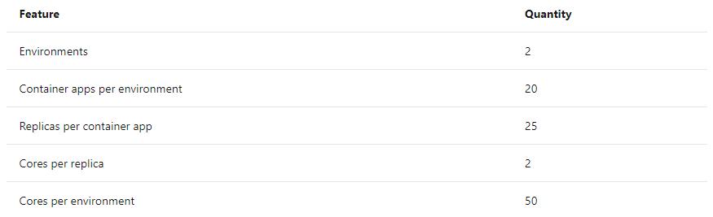
Quotas
Quotas for Azure Container Apps Preview | Microsoft Docs

Slide 19
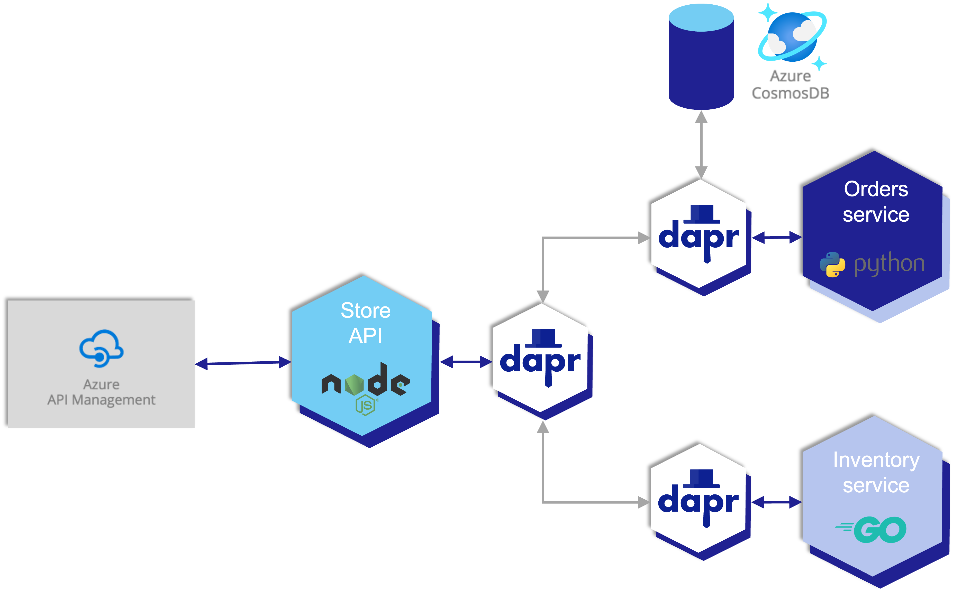
Examples by Jeff Hollan
https://github.com/Azure-Samples/container-apps-connect-multiple-apps
https://github.com/Azure-Samples/container-apps-store-api-microservice/
https://www.youtube.com/watch?v=fmGHEJL81rU&ab_channel=JeffHollan

Slide 20
Start point
https://docs.microsoft.com/en-us/azure/container-apps/
https://www.thorsten-hans.com/introduction-to-azure-container-apps/
Blue/Green deployment with Azure Container Apps - https://denniszielke.medium.com/implementing-continuous-blue-green-deployments-on-azure-container-apps-by-using-github-actions-b4cd5183adb8
Geert Baeke - https://blog.baeke.info/2021/11/03/taking-azure-container-apps-for-a-spin/
WintellectNOW - https://www.youtube.com/watch?v=2CX9S9G89jw&ab_channel=WintellectNOW

Slide 21
Coming soon
More size options
Configuration management
Managed identity
Support for more than 2 Environments
More regions
Custom DNS, Private Link
but, but, but, but….
GA planned for Spring 2022

Slide 22
Final thoughts
Azure Container Apps deserves attentions
Revisions for small projects
Give him a chance ☺

Slide 23


Thank you
Powered by

Slide 24
Demo
Subhead
Main text Example Example Example Example
Example

